Slide 1
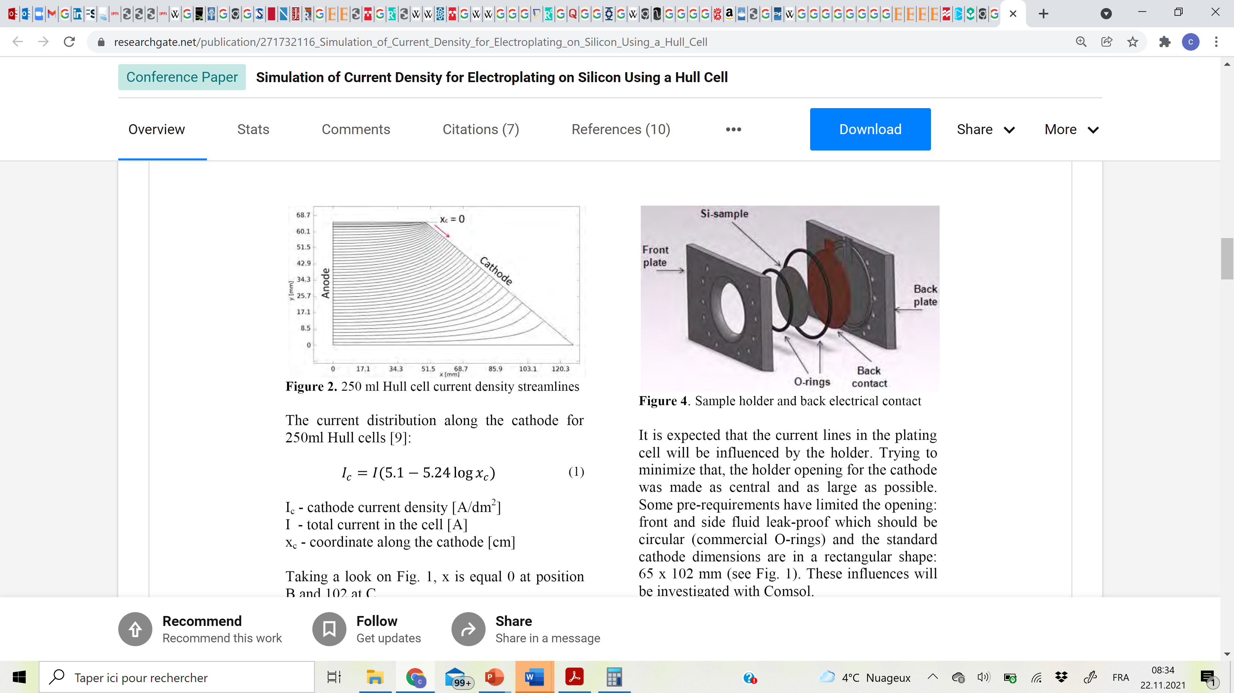
Exercice: The Hull cell
Cathode surface area = 66.3 cm²
Cu and Ni are codeposited at pH 9 in a Hull cell with a total current of 1 A
E⁰(Cu²⁺/Cu) = 0.16 V vs NHE, [Cu²⁺] = 0.05 M, j_{lim} = 275 mA.dm⁻²
E⁰(Ni²⁺/Ni) = -0.23 V vs NHE, [Ni²⁺] = 0.2 M, j_{lim} = 555 mA.dm⁻²
1) Can you estimate the composition profile along x_{c}?
2) Can you predict the current efficiency?
We consider that only HER occurs as a side reaction and that j_{HER} = j_{tot} - j_{lim,Cu} - j_{lim,Ni}
3) What nucleation and growth mechanism, and resulting morphology can you expect?
4) How could you change these results by modifying the electrolyte formulation?
5) What could be the limitations of the Hull cell. How could you overcome them?

